Slide 1
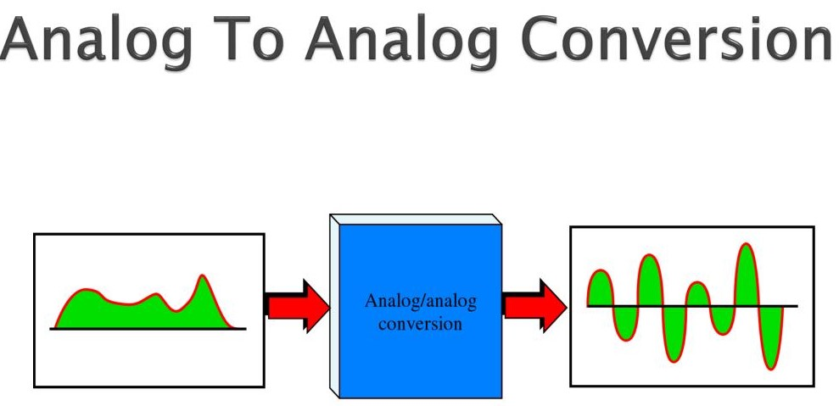
Lec -13
PHYSICAL LAYER: Modulation & Multiplexing
(Analog to Analog conversion)

Slide 2
What is Analog to Analog conversion ?
Analog-to-analog conversion, or analog modulation, is the representation of analog information by an analog signal.
An analog signal is explain as any continuous signal for which the time varying feature of the signal is a representation of some other time varying quantity i.e., analogous to another time varying Signal.
Analog-to-analog conversion is defined as , the representation of analog information by an analog signal. It is a process by virtue of which a characteristic of carrier wave is varied according to the instantaneous amplitude of the modulating signal.

Slide 3
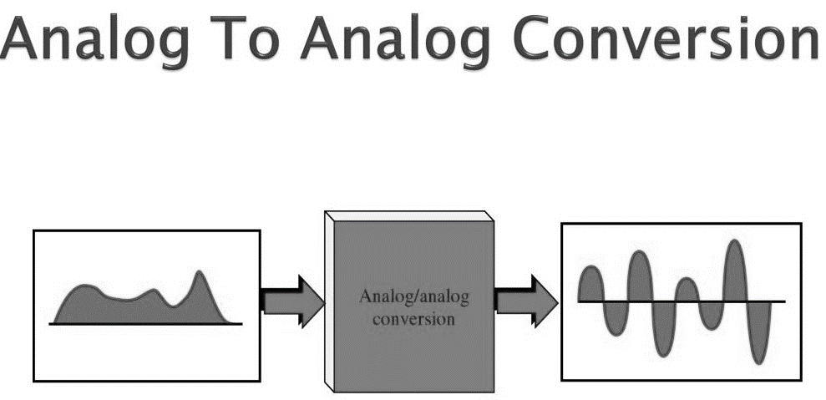
What is main function of A TO A Conversion ?

Slide 4
Types of Analog to Analog conversion .

Slide 5
AMPLITUDE MODULATION
The modulation in which the amplitude of the carrier wave is varied according to the instantaneous amplitude of the modulating signal keeping phase and frequency as constant.
AM is normally implemented by using a simple multiplier because the amplitude of the carrier signal needs to be changed according to the amplitude of the modulating signal.
AM bandwidth:
The modulation creates a bandwidth that is twice the bandwidth of the modulating signal and covers a range centered on the carrier frequency.
Bandwidth= 2fm

Slide 6
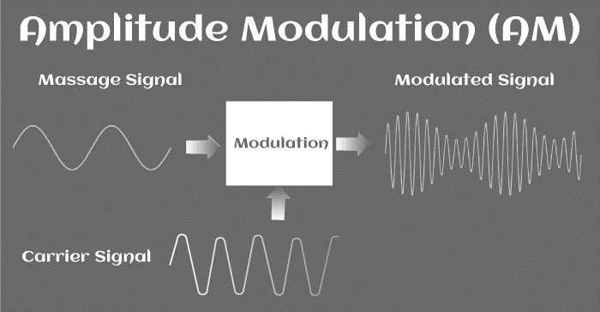
Amplitude Modulation .

Slide 7
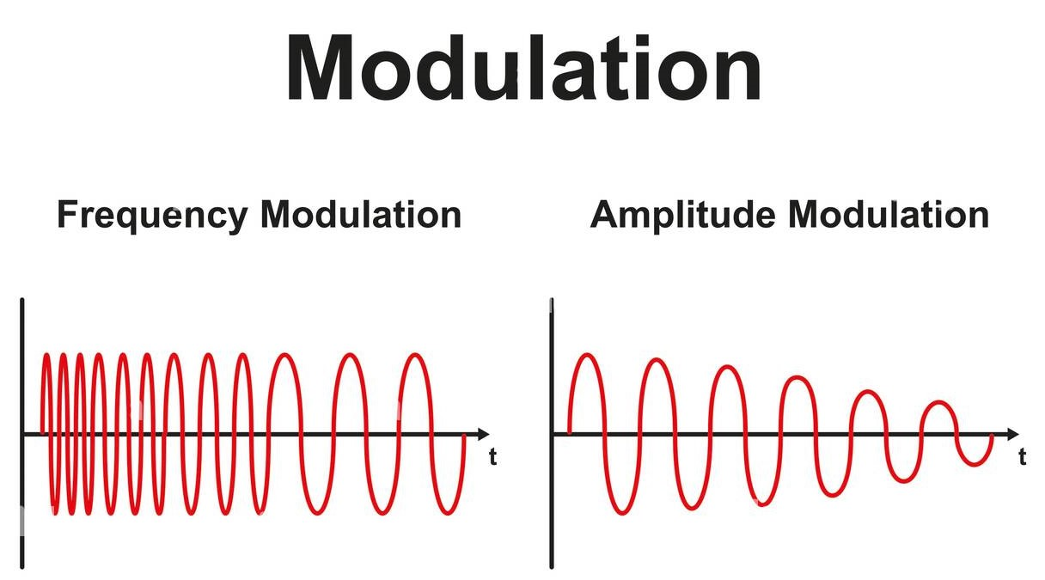
Difference between frequency and amplitude modulation .

Slide 8
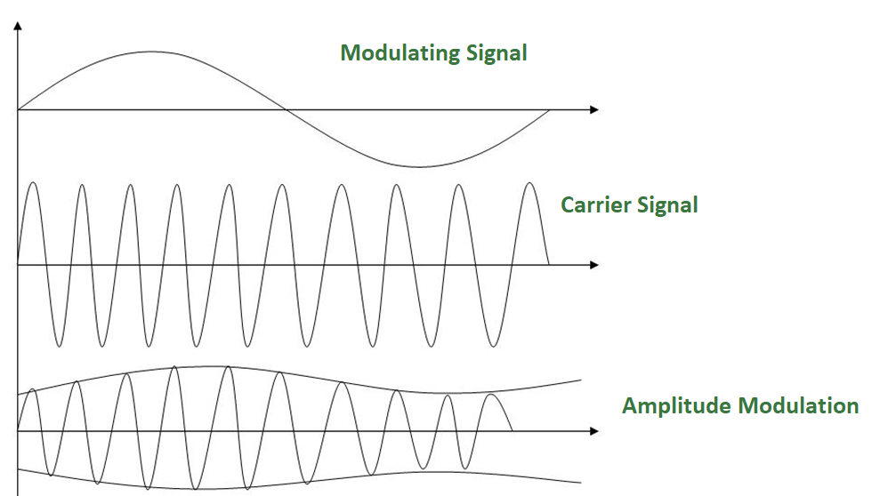
Diagram of Amplitude Modulation.

Slide 9
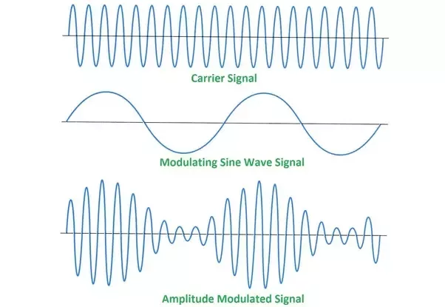
Amplitude Modulated Signal.

Slide 10
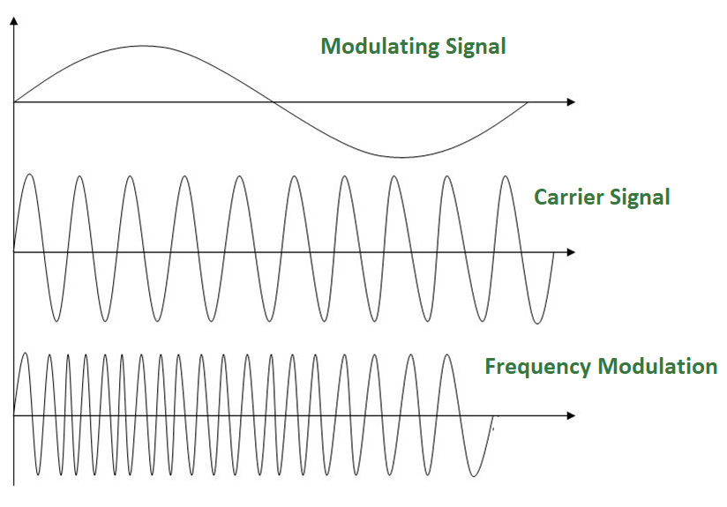
FREQUENCY MODULATION
It is a type of modulation in which the frequency of the carrier wave is varied according to the instantaneous frequency of the modulating signal keeping phase and amplitude as constant. The figure below shows the concept of frequency modulation:

Slide 11
FREQUENCY MODULATION
FM is normally implemented by using a voltage-controlled oscillator as with FSK. The frequency of the oscillator changes according to the input voltage which is the amplitude of the modulating signal.
FM bandwidth:
The bandwidth of a frequency modulated signal varies with both deviation and modulating frequency. If modulating frequency (Mf) 0.5, wide band Fm signal.

Slide 12
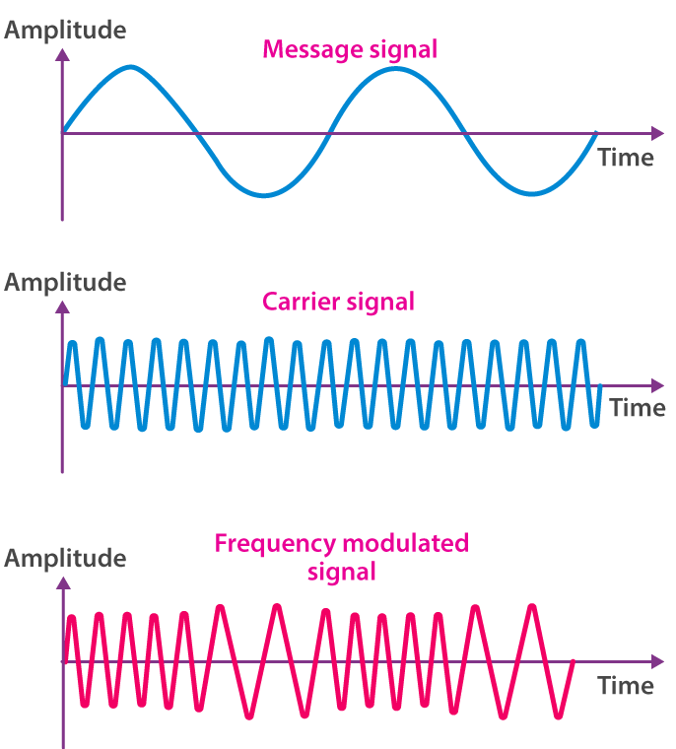
Difference between Message signal , carrier signal and frequency modulated signal.

Slide 13
PHASE MODULATION
Phase modulation is a modulation pattern for conditioning communication signals for transmission. It encodes a message signal as variations in the instantaneous phase of a carrier wave.
Phase modulation is widely used for transmitting radio waves and is an integral part of many digital transmission .
Phase modulation: It is a type of modulation in which the phase of the carrier signal is varied to represent the data being added to the signal.
Phase modulation is defined as the process of varying the phase of the carrier signal linearly with the instantaneous value of the message signal.

Slide 14
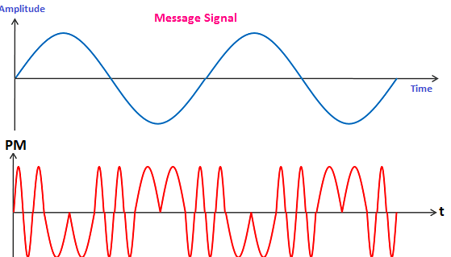
Phase Modulation .

Slide 15
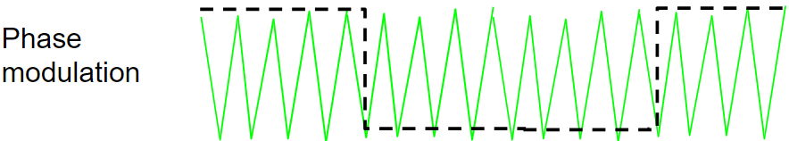
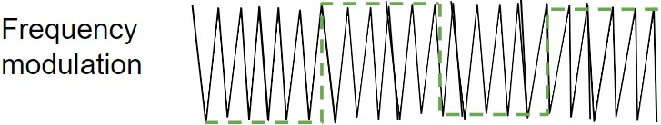
Difference between frequency and phase modulation .

Slide 16
Advantages of Phase Modulation.
High speed- Phase modulation is considered as one the fastest modulation technique. It is due to the pulse generation at high speed.
Low signal power consumption- PM requires low signal power consumption due to its better efficiency and fast speed.
Simple circuit design-The components required in the phase modulated circuit are less as compared to FM. Hence, it has a simple circuit design.
Easy modulation and demodulation-Phase modulation and demodulation is easy as compared to PM due to its simple circuit design.

Slide 17
Disadvantage of Phase Modulation. .
The disadvantages of Phase Modulation are as follows:
Low noise immunity-PM has less noise immunity than FM. It is because the frequencies are less affected by external disturbances than phase. Hence, PM has low noise immunity than FM.
Complex circuitry during conversion from FM to PM
The conversion process from frequency modulation to phase modulation is complex. It is due to the additional components required for the conversion.
Low signal to noise ratio -PM has a low signal to noise ratio than FM. It is due to the higher bandwidth of FM.

Slide 18

Thanks

